Slide 1
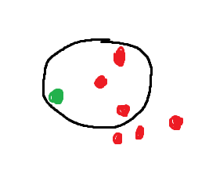
DBSCAN
2 important parameters radius and min Points of neigbhours.
Border points and core points

Slide 2
DBSCAN
Find core points
Do the below for all points:
For a core point if not in a cluster assign a cluster
Find all the connected points to that core point

